Slide 1
CLINICAL SKILLS FOUNDATION COMPONENTS RESPIRATORY SYSTEM EXAMINATION
Dr. Nehaya Mnahi [module leader]
Dr. Hadeel Salman [module co-leader]
Dr. Ahmed Dawai
Dr. Ghada Lateef
Dr.Mustafa Emad

Slide 2
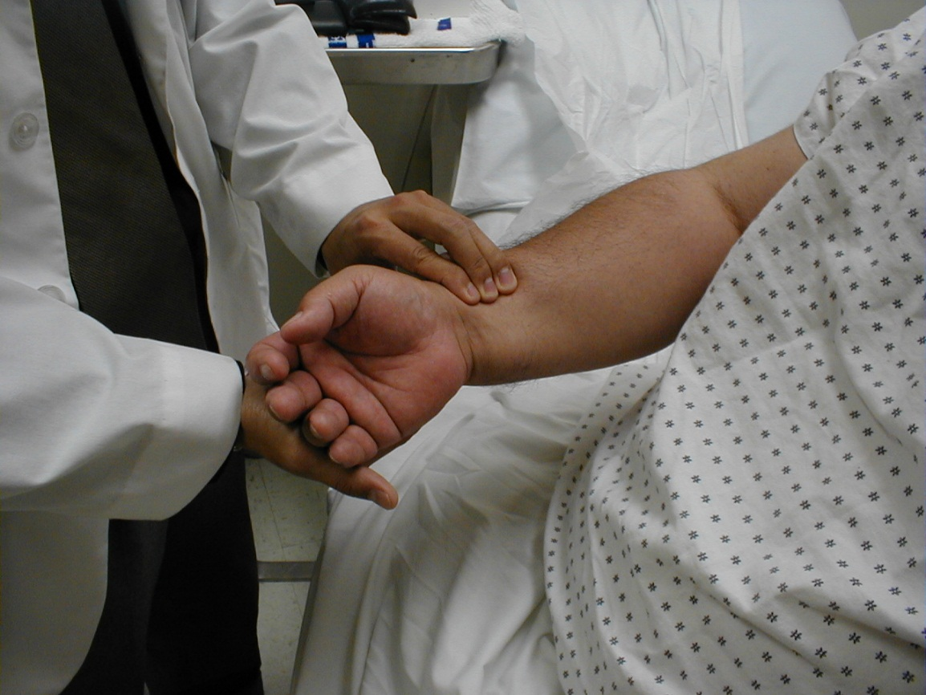
Examination of External Features Of Respiratory System
Observe patients breathlessness, weight , cyanosis and their mental state
Notice if the patient is using the accessory muscles of respiration
Count the respiratory rate (breaths/min) for 30–60 seconds while you feel the pulse
Check the pulse & Blood pressure
Notes:
Diastolic pressure of <60 mmHg is associated with increased mortality in community-acquired pneumonia In pneumothorax, hypotension may indicate the development of ‘tension’ with reduction in venous return to the heart and risk of cardiac arrest.
Pulsus paradoxus is an exaggeration of the normal variability of pulse volume with the respiratory cycle.
A fall in pulse volume and consequent fall in systolic blood pressure of >10 mmHg during inspiration is abnormal and can occur in cardiac tamponade

Slide 3
Abnormal findings
Use of accessory muscles of respiration (sternocleidomastoid, platysma and trapezius muscles)
Severe COPD
Acute severe asthma
If the patient sits forward with the hands/arms on the thighs or knees to ‘fix’ the shoulder girdle, he raises the clavicles and upper chest, increasing lung volume and negative intrathoracic pressure

Slide 4
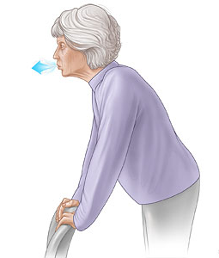
Paradoxical abdomen and chest movement (during inspiration the abdomen moves inwards as the chest wall moves out)
Severe respiratory failure
Bilateral phrenic nerve lesions (diaphragmatic palsy)
Pursed lips (Increases positive end-expiratory pressure, reducing small-airway collapse and improving ventilation)
Severe COPD

Slide 5
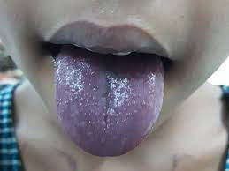
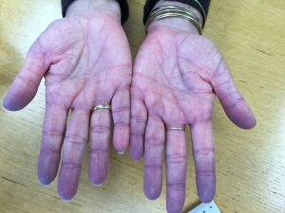
Cyanosis is the blue colour caused by an absolute concentration of deoxygenated haemoglobin of >50 g/l
Central cyanosis occurs when the arterial oxygen saturation falls below 90%, corresponding to a PaO2 of approximately 8 kPa (60 mmHg)
Peripheral cyanosis is only seen in the fingers and toes
Circulatory disorders
Cold
Severe central cyanosis
Notes:
In anaemic or hypovolaemic patients, you may not see cyanosis because severe hypoxia is required to produce the necessary concentration of deoxygenated haemoglobin.
Patients with polycythaemia become cyanosed at higher arterial oxygen tensions.

Slide 6
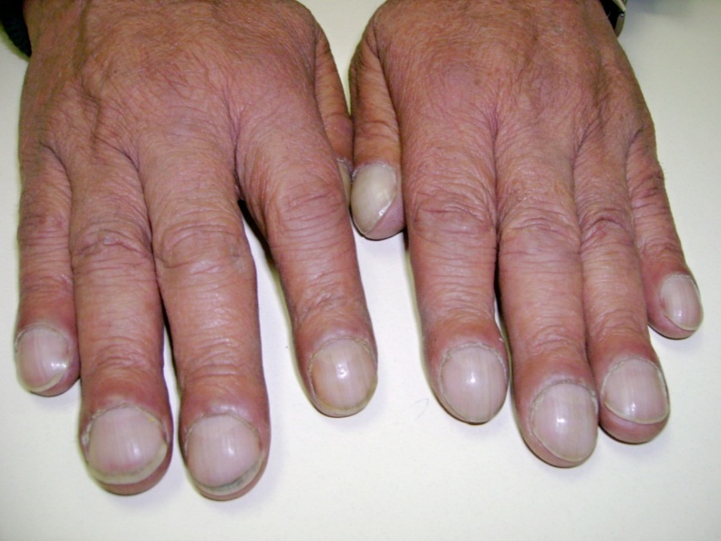
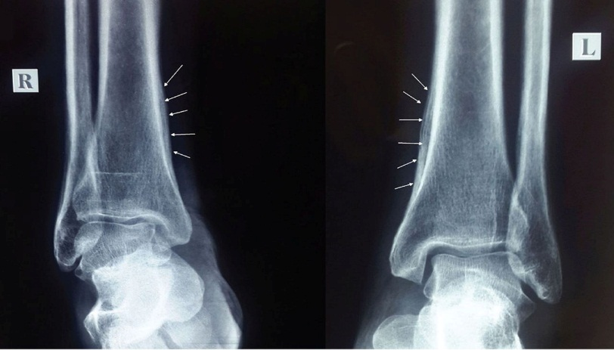
Hands
Clubbing of figures
Lung cancer
Bronchiectasis
Interstitial lung disease
Hypertrophic pulmonary osteoarthropathy
Lung cancer, (Squamous cancer)
Notes:
Pronounced clubbing of fingers and toes occurs, with pain and swelling affecting the wrists and ankles. X-rays of the distal forearm and lower legs show subperiosteal new bone formation separate from the cortex of the long bones

Slide 7
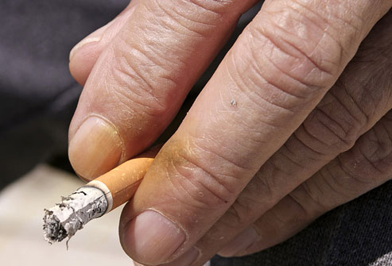
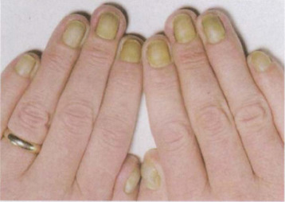
A brownish stain on the fingers and nails in cigarette smokers is caused by tar, not nicotine
Yellow nail syndrome
Lymphedema
Exudative pleural effusion
Termer
Fine finger tremor
Excessive use of β-agonist or theophylline bronchodilator
Coarse flapping tremor (asterixis)
Severe ventilatory failure
Carbon dioxide retention

Slide 8
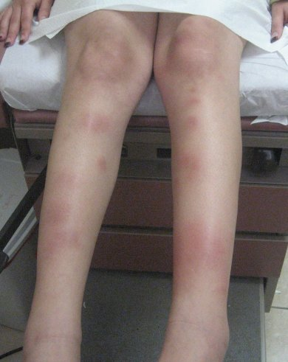
Erythema nodosum over the shins is a feature of acute sarcoidosis and tuberculosis

Slide 9
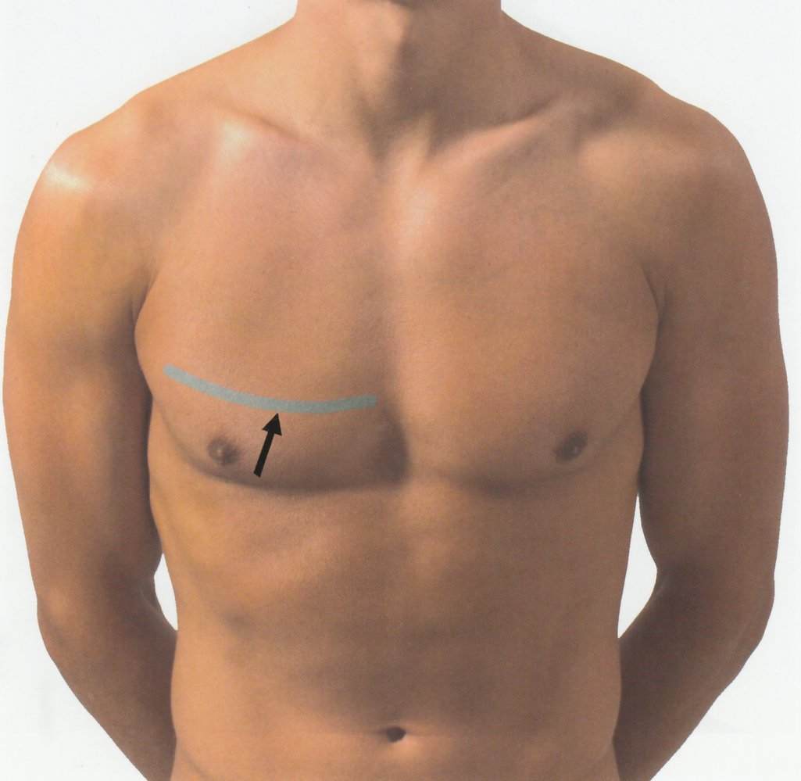
INSPECTION
Chest shape
Normal findings
Symmetrical and elliptical in cross-section (Anteroposterior diameter should be less than the lateral diameter)

Slide 10
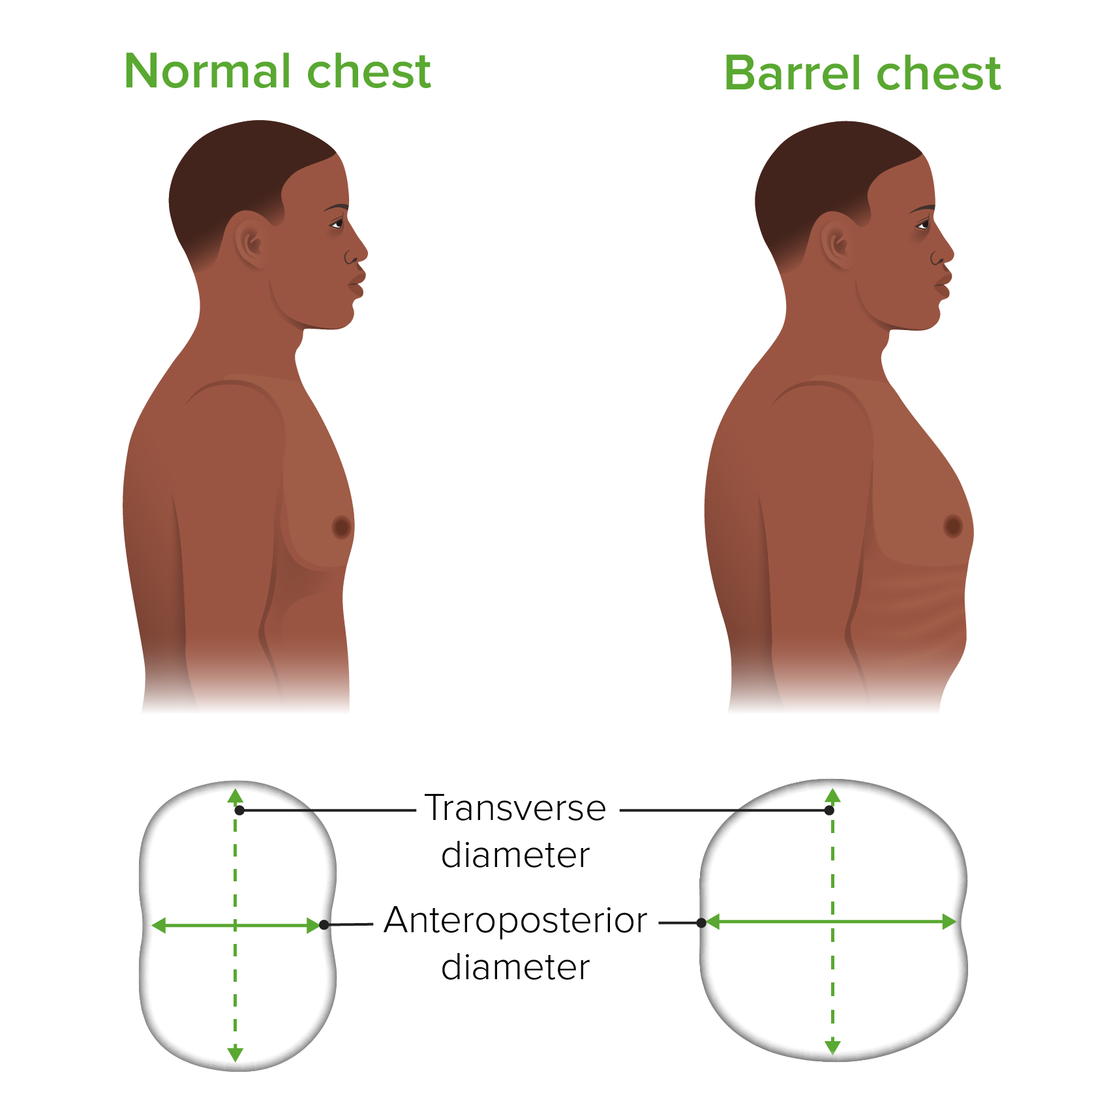
Abnormal findings
Barrel-shaped
Hyperinflation (Severe COPD)
Notes:
Reduce ventilatory capacity and increase the work of breathing
These patients develop progressive ventilatory failure with carbon dioxide retention and cor-pulmonale at an early age.

Slide 11
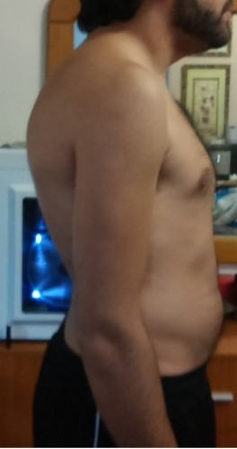
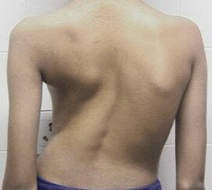
Kyphosis
Scoliosis
Kyphoscoliosis
Idiopathic
Secondary to childhood poliomyelitis or spinal tuberculosis

Slide 12
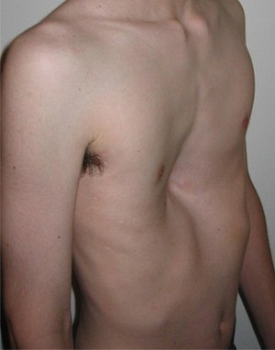
Pectus Carinatum (Pigeon chest)
Hyperinflation with repeated vigorous contractions of the diaphragm while the bony thorax is in a pliable prepubertal state
Severe and poorly controlled childhood asthma
Osteomalacia and rickets)
Pectus Excavatum (Funnel chest)
Developmental deformity

Slide 13
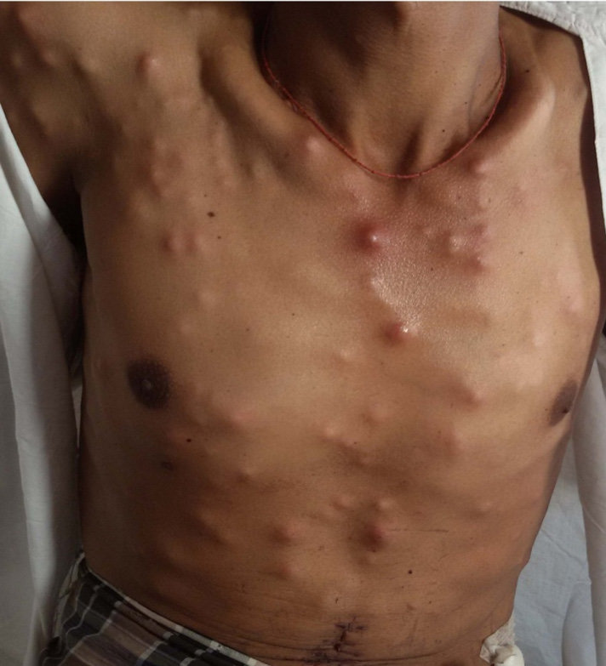
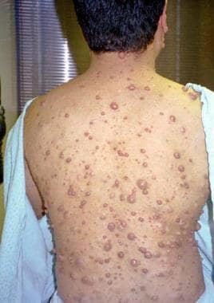
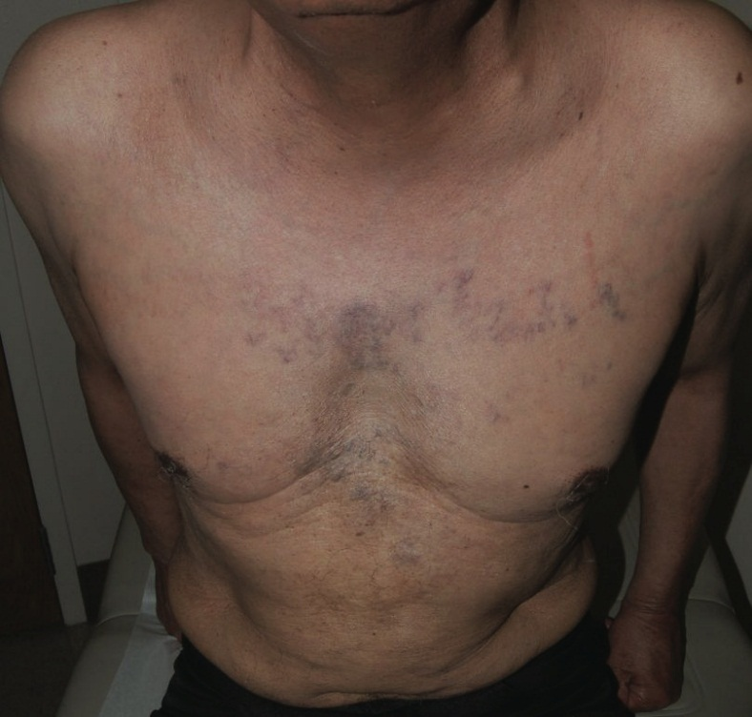
Skin
Metastatic tumour nodules
Neurofibromas and lipomas
The dilated venous vascular channels of SVCO

Slide 14
PALPATION
Examining the trachea and cardiac apex beat
Palpation for chest wall tenderness
Chest expiation
Abnormal findings
Tracheal deviation→ Shift of the upper mediastinum
Displacement of the cardiac apex beat → indicate shift of the lower mediastinum
Tracheal tug is found in severe hyperinflation
Chest wall tenderness is found in
Tietze’s syndrome (Costochondritis )
Over areas of pulmonary infarction
Over areas fracture

Slide 15
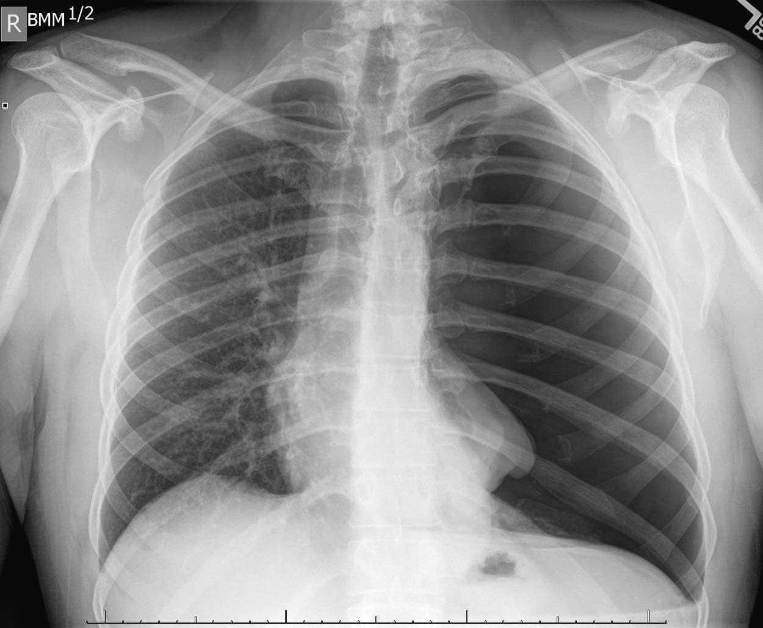

Slide 16
Chest Expansion
By using both hands
By using tape measures
Abnormal findings
Unilateral reduced chest expansion indicates abnormality on that side: (Pleural effusion, Lung or lobar collapse, Pneumothorax and unilateral fibrosis)
Bilateral reduction in chest expansion (Severe COPD and diffuse pulmonary fibrosis)

Slide 17
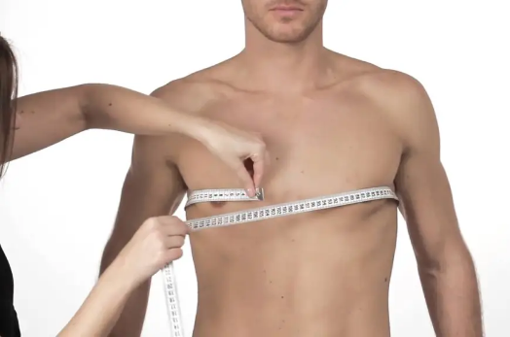

Slide 18
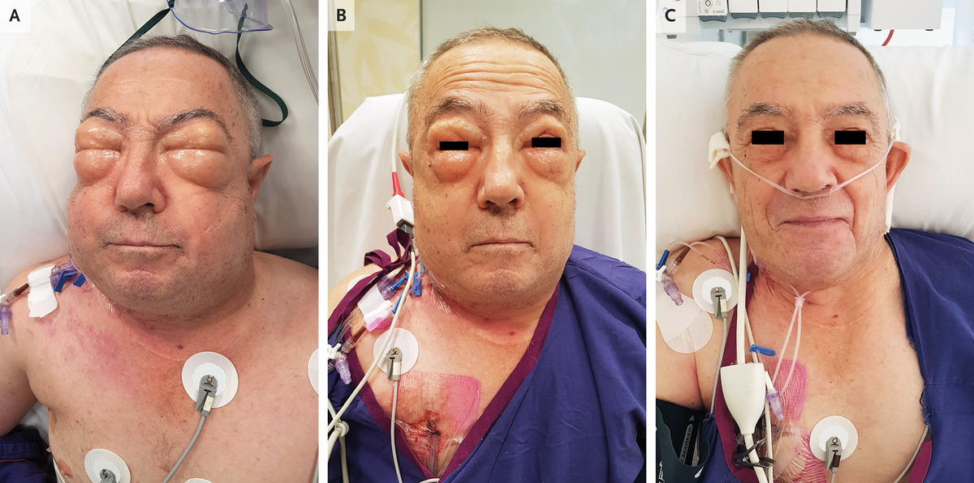
Subcutaneous emphysema produces a crackling sensation over gas-containing tissue
Severe acute asthma
Spontaneous or traumatic pneumothorax
Rupture of the oesophagus
Complication of intercostal drainage

Slide 19
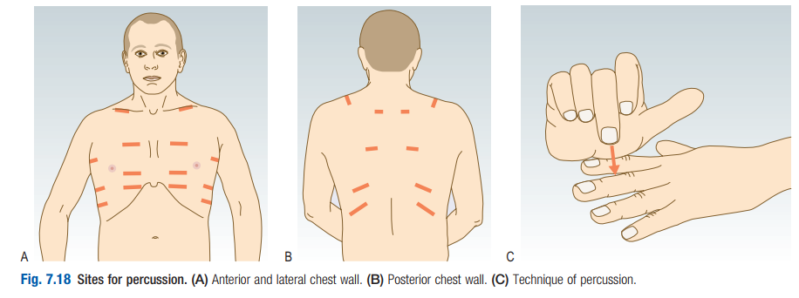
PERCUSSION
Percussion allows you to hear the pitch and loudness of the percussed note

Slide 21
AUSCULTATION
Most sounds reaching the chest wall are low-frequency and best heard with the stethoscope bell
Notes:
Listen with the patient relaxed and breathing deeply through his open mouth. Avoid asking him to breathe deeply for prolonged periods, as this causes giddiness and even tetany. Auscultate each side alternately, comparing findings over a large number of equivalent positions to ensure that you do not miss localized abnormalities.
Listen: ■ anteriorly from above the clavicle down to the sixth rib ■ laterally from the axilla to the eighth rib ■ posteriorly down to the level of the 11th rib.
Assess the quality and amplitude of the breath sounds. Identify any gap between inspiration and expiration, and listen for added sounds. Avoid auscultation within 3 cm of the midline anteriorly or posteriorly, as these areas may transmit sounds directly from the trachea or main bronchi

Slide 22
Normally
Rustling (vesicular) quality ,inspiratory phase longer than expiratory phase
Abnormal findings
Diminished vesicular breathing occurs in
Obesity
Pleural effusion
Marked pleural thickening
Pneumothorax
Hyperinflation due to COPD
Over an area of collapse (major bronchus is occluded)

Slide 23
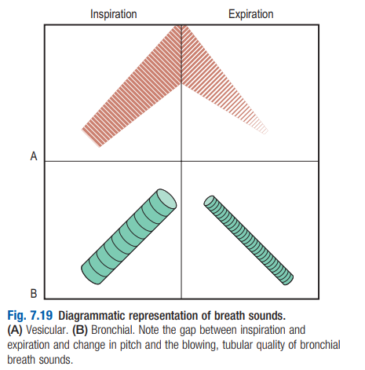
Bronchial breathing
A high-pitched breath sound with a hollow or blowing quality, are found when normal lung tissue is replaced by uniformly conducting tissue and the underlying major bronchus is patent
Similar length and intensity in inspiration and expiration
Pause between the two phases
Notes:
so it tends to exclude the possibility of an obstructing lung cancer.

Slide 24
Whispering Pectoriloquy & Aegophony
Whispering Pectoriloquy are heard over
Pulmonary consolidation (pneumonia)
At the upper level of a pleural effusion
Areas of dense fibrosis
Aegophony is a bleating or nasal sound heard over
Consolidated lung (pneumonia)
At the upper level of a pleural effusion
Notes:
It is due to enhanced transmission of high-frequency noise across abnormal lung, with lower frequencies filtered out

Slide 25
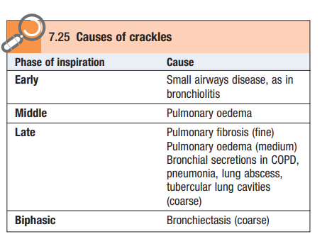
Added sounds
Crackles are interrupted non-musical sounds and result from
Collapse of peripheral airways on expiration*
air bubbles through secretions in major bronchi, dilated bronchi in Bronchiectasis or in pulmonary cavities.**
Notes:
*On inspiration, air rapidly enters these distal airways, and the alveoli and small bronchi open abruptly, producing the crackling noise.
** These crackles sound coarse, have a gurgling quality and change if the secretions are dislodged by coughing.

Slide 26
Wheeze
Musical quality sounds imply airway narrowing
They are louder on expiration*
Inspiratory wheeze implies severe airway narrowing
High-pitched wheeze arises from smaller airways and has a whistling quality
Low pitched wheeze originates from larger bronchi
Asthma
COPD **
Lung cancer (Localised wheeze with a single musical note that does not clear on coughing)
Notes:
*Because airways normally dilate during inspiration and narrow on expiration
**Poor guide to severity of airflow obstruction

Slide 27
A pleural friction rub is a creaking sound similar to that produced by bending stiff leather or walking in fresh snow
It is produced when inflamed parietal and visceral pleurae move over one another and is best heard with the stethoscope diaphragm
Heard over
Areas of inflamed pleura
Pulmonary infarction due to pulmonary embolism
Notes:
It may be heard only on deep breathing at the end of inspiration and beginning of expiration. A pleural rub is usually associated with pleuritic pain and

